Slide 1

Hotel Booking Optimization
Zhiming Xie (zx284) and Jaeha Kim (jk2894)

Slide 2
-Project goal
-Dataset background
-Feature engineering
-Model selection
-Conclusion

Slide 3

Project Goal
1. Intro
2. Pre-pr
ocessing
3. Model
selection
4. Result
CHECK-IN
CANCEL
Customer
Hotel
Notes:
Motivation of the problem & justifications of the selected dataset
What is the question being examined?
How many features? How many observations? Are they integer? String? Categorical? Ordinal? How many percentage of people cancel? Where these data come from

Slide 4
Project Goal
1. Intro
2. Pre-pr
ocessing
3. Model
selection
4. Result
CHECK-IN
CANCEL
Customer
Hotel
Notes:
How many features? How many observations? Are they integer? String? Categorical? Ordinal? How many percentage of people cancel? Where these data come from

Slide 5
Dataset Background
1. Intro
2. Pre-pr
ocessing
3. Model
selection
4. Result
Variable (Type) | Description | Variable (Type) | Description |  | Variable (Type) | Description | Variable (Type) | Description
ADR (Numeric) | Average Daily Rate (Price) | Adults (Integer) | Number of adults |  | Stays In Weekend Nights (Integer) | Number of weekend nights the guest stayed or booked | Stays In Week Nights (Integer) | Number of week nights the guest stayed or booked
Babies (integer) | Number of babies | Children (Integer) | Number of children |  | Arrival Date Day Of Month (Integer) | Day of the Month of the arrival date | Arrival Date Month (Categorical) | Month of arrival date with 12 categories (January to December)
Country (Categorical) | Country of Origin | CustomerType (Categorical) | Contract / Group / Transient (not contract and not group) / Transient-Party (associated with other transient booking) |  | Arrival Date Year (Integer) | Year of arrival date | Arrival Date Week Number (integer) | Week number of the arrival date
Meal (Categorical) | Undefined/SC: No meal package BB: Bed & Breakfast HB: Half board (breakfast and one other meal) FB: Full board (breakfast, lunch, and dinner) | Required Car Parking Spaces (Integer) | Number of car parking spaces required by the customer |  | Lead Time (Integer) | Number of days that elapsed between the entering date of the booking into the PMS and the arrival date | Days In Waiting List (Integer) | Number of days the booking was in the waiting list before it was confirmed to the customer
Reserved Room Type (Categorical) | Code of room type reserved | Assigned Room Type (Categorical) | Code for the type of room assigned |  | Reservation Status Date (Date) | Date at which the last status was set.
Total Of Special Requests (Integer) | Number of special requests made by the customer (twin bed or high floor) | Booking Changes (Integer) | Number of changes/ amendments made to the booking from the moment of check-in or cancellation |  | Agent (Categorical) | ID of the travel agency that made the booking | Company (Categorical) | ID of the company/entity that made the booking or responsible for paying the booking
Is Repeated Guest (Categorical) | Repeated guest (1) or not (0) |  |  |  | Distribution Channel (Categorical) | Booking distribution channel (TA: travel agents, TO: Tour Operators) | Market Segment (Categorical) | Market segment destination (TA: travel agents, TO: Tour Operators)
Previous Cancellations (Integer) | Number of previous bookings that were canceled by the customer | PreviousBookings_NotCanceled (integer) | Number of previous bookings not cancelled by the customer |  | Deposit Type (Categorical) | No Deposit Non Refund Refundable
 |  |  |  |  | Reservation Status (Categorical) | Canceled Check-out No-show | IsCanceled (Categorical) | Canceled(1) Or not (0)
Notes:
How many features? How many observations? Are they integer? String? Categorical? Ordinal? How many percentage of people cancel? Where these data come from
What is the structure of the dataset and how many variables/conditions were used?

Slide 6
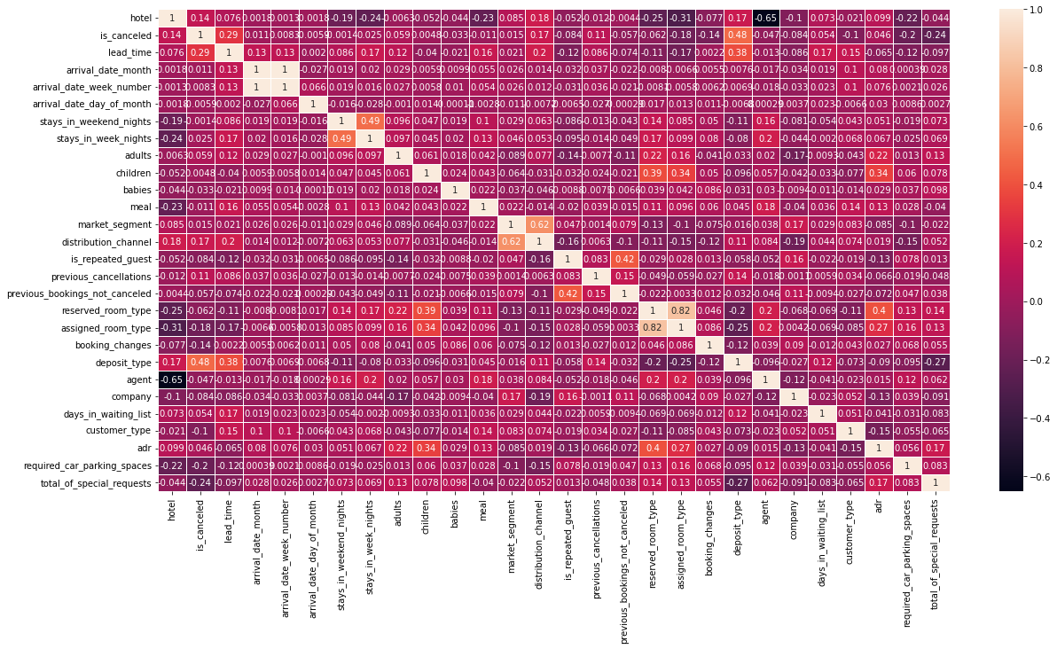
Correlation heatmap
1. Intro
2. Pre-pr
ocessing
3. Model
selection
4. Result
Notes:
Which data

Slide 7
Feature engineering
1. Intro
2. Pre-pr
ocessing
3. Model
selection
4. Result
Drop invalid data
Remove Overlapping features
Convert categorical features to integers
Normalize data
Split train and test datasets
Notes:
How were outliers removed (if applicable)?
How was missing data accounted for (if applicable)?
How was the data normalized (if applicable)?

Slide 8
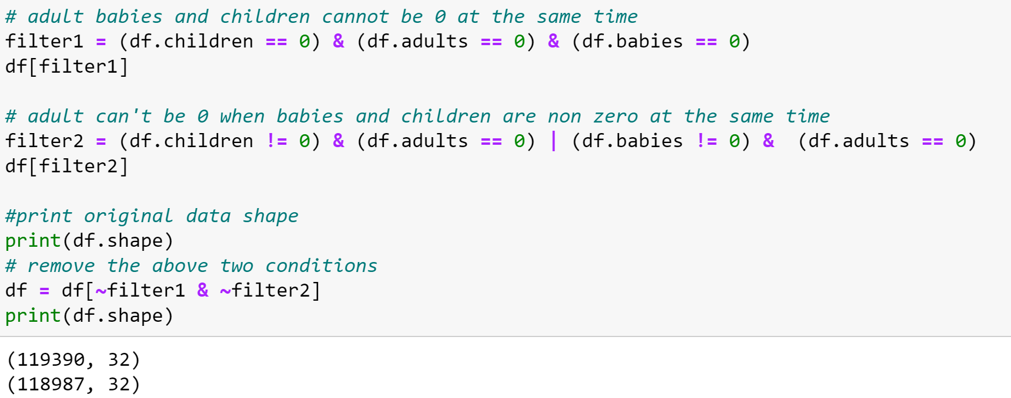
Feature engineering
1. Intro
2. Pre-pr
ocessing
3. Model
selection
4. Result
Drop invalid data
Overlapping features
Converted categorical features to integers
Normalize data
Split train and test datasets
Notes:
How were outliers removed (if applicable)?
How was missing data accounted for (if applicable)?
How was the data normalized (if applicable)?

Slide 9
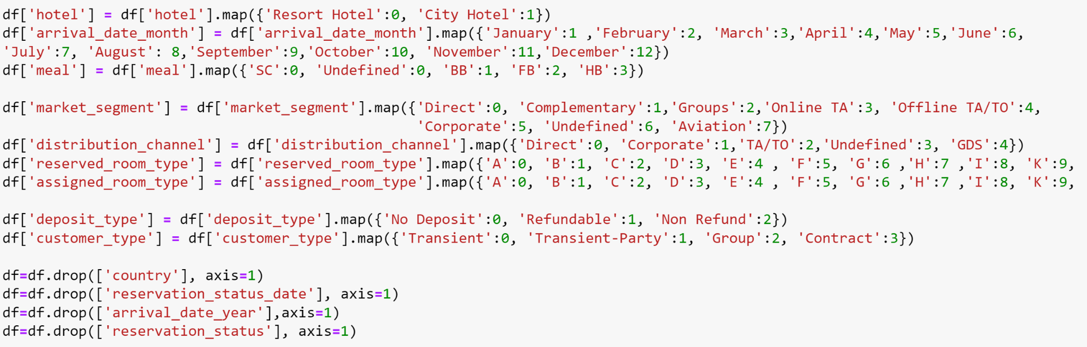
Feature engineering
1. Intro
2. Pre-pr
ocessing
3. Model
selection
4. Result
Drop invalid data
Remove Overlapping features
Notes:
How were outliers removed (if applicable)?
How was missing data accounted for (if applicable)?
How was the data normalized (if applicable)?

Slide 10
Feature engineering
1. Intro
2. Pre-pr
ocessing
3. Model
selection
4. Result
Drop invalid data
Remove Overlapping features
Convert categorical features to integers
Normalize data
Split train and test datasets
Notes:
How were outliers removed (if applicable)?
How was missing data accounted for (if applicable)?
How was the data normalized (if applicable)?

Slide 11
[Recap] Feature engineering
1. Intro
2. Pre-pr
ocessing
3. Model
selection
4. Result
Drop invalid data
Remove Overlapping features
Convert categorical features to integers
Normalize data
Split train and test datasets
Notes:
How were outliers removed (if applicable)?
How was missing data accounted for (if applicable)?
How was the data normalized (if applicable)?

Slide 12
Feature engineering
1. Intro
2. Pre-pr
ocessing
3. Model
selection
4. Result
Variable (Type) | Description | Variable (Type) | Description |  | Variable (Type) | Description | Variable (Type) | Description
ADR (Numeric) | Average Daily Rate (Price) | Adults (Integer) | Number of adults |  | Stays In Weekend Nights (Integer) | Number of weekend nights the guest stayed or booked | Stays In Week Nights (Integer) | Number of week nights the guest stayed or booked
Babies (Integer) | Number of babies | Children (Integer) | Number of children |  | Arrival Date Day Of Month (Integer) | Day of the Month of the arrival date | Arrival Date Month (Integer) | Month of arrival date with 12 categories (January to December)
Country (Categorical) | Country of Origin | CustomerType (Integer) | Contract / Group / Transient (not contract and not group) / Transient-Party (associated with other transient booking) |  | Arrival Date Year (Integer) | Year of arrival date | Arrival Date Week Number (integer) | Week number of the arrival date
Meal (Integer) | Undefined/SC: No meal package BB: Bed & Breakfast HB: Half board (breakfast and one other meal) FB: Full board (breakfast, lunch, and dinner) | Required Car Parking Spaces (Integer) | Number of car parking spaces required by the customer |  | Lead Time (Integer) | Number of days that elapsed between the entering date of the booking into the PMS and the arrival date | Days In Waiting List (Integer) | Number of days the booking was in the waiting list before it was confirmed to the customer
Reserved Room Type (Integer) | Code of room type reserved | Assigned Room Type (Integer) | Code for the type of room assigned |  | Reservation Status Date (Date) | Date at which the last status was set.
Total Of Special Requests (Integer) | Number of special requests made by the customer (twin bed or high floor) | Booking Changes (Integer) | Number of changes/ amendments made to the booking from the moment of check-in or cancellation |  | Agent (Categorical) | ID of the travel agency that made the booking | Company (Categorical) | ID of the company/entity that made the booking or responsible for paying the booking
Is Repeated Guest (Categorical) | Repeated guest (1) or not (0) |  |  |  | Distribution Channel (Integer) | Booking distribution channel (TA: travel agents, TO: Tour Operators) | Market Segment (Integer) | Market segment destination (TA: travel agents, TO: Tour Operators)
Previous Cancellations (Integer) | Number of previous bookings that were canceled by the customer | PreviousBookings_NotCanceled (integer) | Number of previous bookings not cancelled by the customer |  | Deposit Type (Integer) | No Deposit Non Refund Refundable
 |  |  |  |  | Reservation Status (Categorical) | Canceled Check-out No-show | IsCanceled (Categorical) | Canceled(1) Or not (0)
Notes:
How many features? How many observations? Are they integer? String? Categorical? Ordinal? How many percentage of people cancel? Where these data come from
What is the structure of the dataset and how many variables/conditions were used?

Slide 13
Model Selection Process
1. Intro
2. Pre-pr
ocessing
3. Model
selection
4. Result
Hyperparameter tuning by cross-validation
Compared all models
Applying PCA to the dataset
Hyperparameter tuning by cross-validation
Compared all models
Notes:
Testing multiple models and compared weighted F1 score from cross validation //

Slide 14
Testing Models
1. Intro
2. Pre-pr
ocessing
3. Model
selection
4. Result
[Hyper-parameter Tuning (CV)]
[Dimension Reduction
+Hyper-parameter Tuning (CV)]
Logistic Regression
Decision Tree
Random Forest
AdaBoost
XGBoost
Gradient Boosting
Logistic Regression
Decision Tree
Random Forest
AdaBoost
XGBoost
Gradient Boosting
Notes:
Testing multiple models and compared weighted F1 score from cross validation //

Slide 15
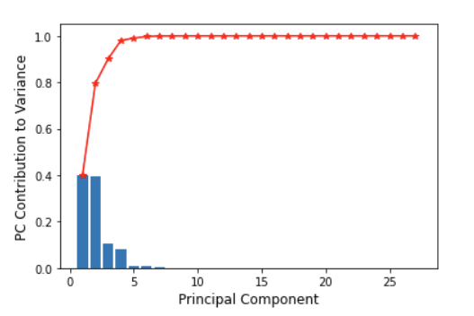
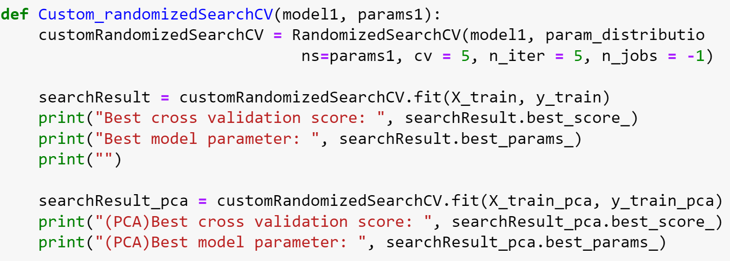
Dimensionality reduction & Cross Validation
1. Intro
2. Pre-pr
ocessing
3. Model
selection
4. Result
[Cross-validation]
[Dimension Reduction: PCA]
: Applied the same randomizedSearchCV for different models
: 6 PCs capture 99.5% of the total variations
Notes:
Testing multiple models and compared weighted F1 score from cross validation //

Slide 16
1. Logistic Regression
1. Intro
2. Pre-pr
ocessing
3. Model
selection
4. Result
Testing Hyper-parameters:
'penalty' : ['l1', 'l2', 'elasticnet', 'none'],
'C' : np.logspace(-4, 4, 20),
'solver' :['lbfgs','newton-cg','liblinear','sag','saga'],
'max_iter' : [100, 1000,2500, 5000]
Best score parameters for non-pca:
Best cross validation score: 0.7980
Best model parameter: {'solver': 'liblinear', 'penalty': 'l1', 'max_iter': 100, 'C': 11.288378916846883}
Best score parameters for pca:
(PCA)Best cross validation score: 0.6675
(PCA)Best model parameter: {'solver': 'liblinear', 'penalty': 'l1', 'max_iter': 5000, 'C': 1.623776739188721}
Notes:
Testing multiple models and compared weighted F1 score from cross validation //

Slide 17
2. Decision Tree
1. Intro
2. Pre-pr
ocessing
3. Model
selection
4. Result
Testing Hyper-parameters:
"max_depth": [3, None],
"max_features": randint(1, 9),
"min_samples_leaf": randint(1, 9),
"criterion": ["gini", "entropy"]
Best score parameters for non-pca:
Best cross validation score: 0.8266
Best model parameter: {'criterion': 'gini', 'max_depth': None, 'max_features': 8, 'min_samples_leaf': 6}
Best score parameters for pca:
(PCA)Best cross validation score: 0.7733
(PCA)Best model parameter: {'criterion': 'gini', 'max_depth': None, 'max_features': 5, 'min_samples_leaf': 2}
Notes:
Testing multiple models and compared weighted F1 score from cross validation //

Slide 18
3. Random Forest
1. Intro
2. Pre-pr
ocessing
3. Model
selection
4. Result
Testing Hyper-parameters:
'n_estimators': randint(4,150),
'max_features': truncnorm(a=0, b=1, loc=0.25, scale=0.1),
'min_samples_split': uniform(0.01, 0.199)
Best score parameters for non-pca:
Best cross validation score: 0.8239
Best model parameter: {'max_features': 0.3317105092985048, 'min_samples_split': 0.014170012193764785, 'n_estimators': 19}
Best score parameters for pca:
Best cross validation score: 0.7211
Best model parameter: {'max_features': 0.2692143398292158, 'min_samples_split': 0.01760989011315945, 'n_estimators': 144}
Notes:
Testing multiple models and compared weighted F1 score from cross validation //

Slide 19
4. AdaBoost
1. Intro
2. Pre-pr
ocessing
3. Model
selection
4. Result
Testing Hyper-parameters:
‘n_estimators':[50,100,200],
'learning_rate':[.001,0.01,.1]
Best score parameters for non-pca:
Best cross validation score: 0.8142
Best model parameter: {'learning_rate': 0.1, 'n_estimators': 200}
Best score parameters for pca:
Best cross validation score: 0.6764
Best model parameter: {'learning_rate': 0.1, 'n_estimators': 200}
Notes:
Testing multiple models and compared weighted F1 score from cross validation //

Slide 20
5. XGBoost
1. Intro
2. Pre-pr
ocessing
3. Model
selection
4. Result
Testing Hyper-parameters:
'learning_rate' : [0.05,0.10,0.15,0.20,0.25,0.30],
'max_depth' : [ 3, 4, 5, 6, 8, 10, 12, 15],
'min_child_weight' : [ 1, 3, 5, 7 ],
'gamma': [ 0.0, 0.1, 0.2 , 0.3, 0.4 ],
'colsample_bytree' : [ 0.3, 0.4, 0.5 , 0.7 ]
Best score parameters for non-pca:
Best cross validation score: 0.8625
Best model parameter: {'min_child_weight': 7, 'max_depth': 15, 'learning_rate': 0.3, 'gamma': 0.1, 'colsample_bytree': 0.7}
Best score parameters for pca:
Best cross validation score: 0.7949
Best model parameter: {'min_child_weight': 1, 'max_depth': 12, 'learning_rate': 0.3, 'gamma': 0.4, 'colsample_bytree': 0.5}
Notes:
Testing multiple models and compared weighted F1 score from cross validation //

Slide 21
6. Gradient Boosting
1. Intro
2. Pre-pr
ocessing
3. Model
selection
4. Result
Testing Hyper-parameters:
'loss': ['deviance', 'exponential'],
'learning_rate': sp_randFloat(),
'subsample' : sp_randFloat(),
'n_estimators' : sp_randInt(100, 1000),
'max_depth' : sp_randInt(4, 10)
Best Score parameters for non-pca:
Best cross validation score: 0.8388679234371239
Best model parameter: {'learning_rate': 0.7147272601158047, 'loss': 'deviance', 'max_depth': 5, 'n_estimators': 170, 'subsample': 0.5523246055451324}
Best Score parameters for pca:
(PCA)Best cross validation score: 0.7899547275261174
(PCA)Best model parameter: {'learning_rate': 0.1584647686052979, 'loss': 'deviance', 'max_depth': 6, 'n_estimators': 765, 'subsample': 0.6702564273974573}
Notes:
Testing multiple models and compared weighted F1 score from cross validation //

Slide 22
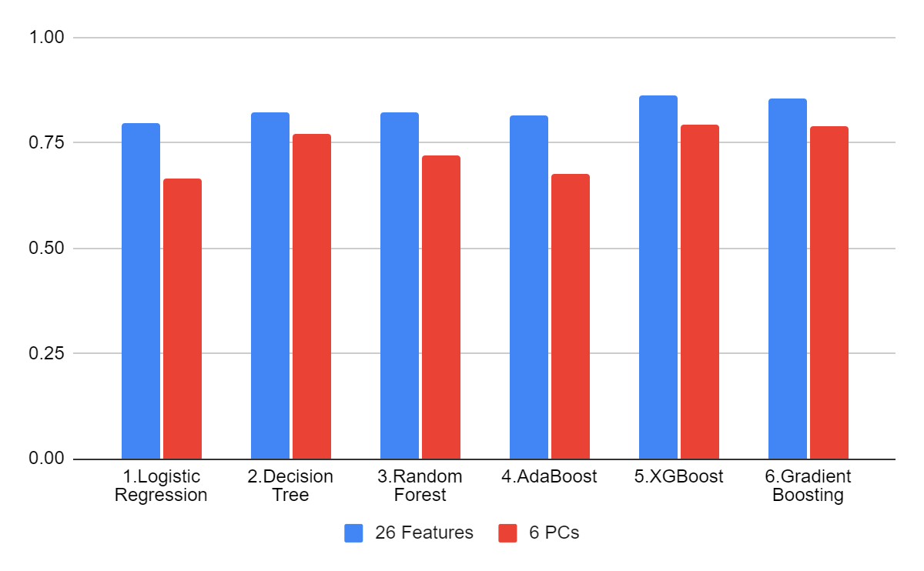
Model Testing Result - Accuracy
1. Intro
2. Pre-pr
ocessing
3. Model
selection
4. Result
Notes:
Testing multiple models and compared weighted F1 score from cross validation //

Slide 23
Model Testing Result
1. Intro
2. Pre-pr
ocessing
3. Model
selection
4. Result
Model | 26 Features | 6 PCs
1.Logistic Regression | 0.7974 | 0.6660
2.Decision Tree | 0.8247 | 0.7702
3.Random Forest | 0.8239 | 0.7211
4.AdaBoost | 0.8142 | 0.6764
5.XGBoost | 0.8625 | 0.7947
6.Gradient Boosting | 0.8570 | 0.7917
Notes:
Testing multiple models and compared weighted F1 score from cross validation //

Slide 24
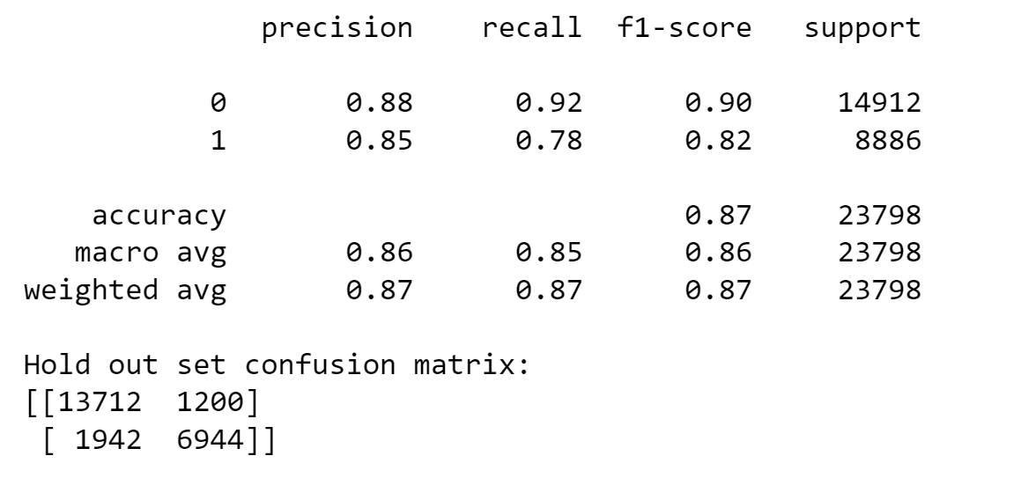
Conclusion
The best model is XGBoost
1. Intro
2. Pre-pr
ocessing
3. Model
selection
4. Result
Testing Hyper-parameters: 'learning_rate' : [0.05,0.10,0.15,0.20,0.25,0.30], 'max_depth' : [ 3, 4, 5, 6, 8, 10, 12, 15], 'min_child_weight' : [ 1, 3, 5, 7 ], 'gamma': [ 0.0, 0.1, 0.2 , 0.3, 0.4 ], 'colsample_bytree' : [ 0.3, 0.4, 0.5 , 0.7 ] Best cross validation score: 0.8625 | Best cross validation score: 0.8644
Best Hyper-parameters from CV: Best model parameter: {'min_child_weight': 3, 'max_depth': 15, 'learning_rate': 0.15, 'gamma': 0.4, 'colsample_bytree': 0.4} Accuracy: 0.87

Slide 25
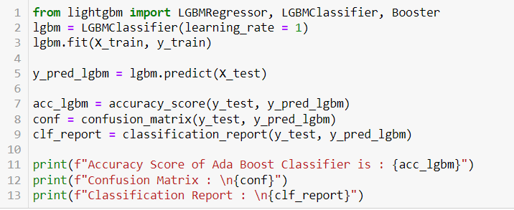
Other Methods Could Have Been Used
1. Intro
2. Pre-pr
ocessing
3. Model
selection
4. Result
-Methods: LightGBM (LGBM)
-LGBM uses gradient-based one-side sampling to find the split value for the data instances. It is 7 times faster than XGBOOST.

